Slide 1




PDC PROJECT
IBRAHIM SHAHID
TALHA AHMAD
OMER MUSTAFA
INDEPENDENT SPANNING TREES
IN
BUBBLE SORT
NETWORKS

Slide 2
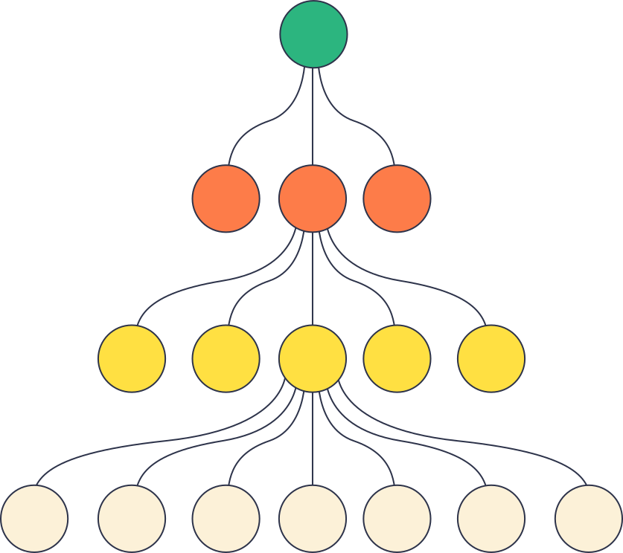

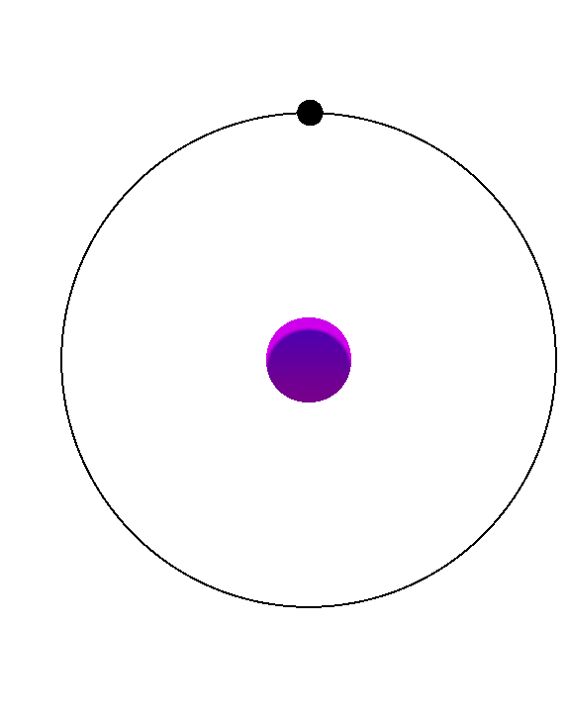
WHAT’S THE PROBLEM?
Goal: Build multiple "backup paths" (ISTs) in a special network called a bubble-sort network.
Why? If one path fails (e.g., broken connections), data can reroute through another path.
Challenge: Earlier methods were recursive (like solving a puzzle by breaking it into smaller puzzles), which is slow and hard to parallelize.

Slide 3
Independent Spanning Trees (ISTs): Imagine building multiple roadmaps in a city where no two roadmaps share the same roads or intersections.
Bubble-Sort Network (Bn): A network where each node is a permutation of numbers (e.g., for n=3, nodes are 123, 132, 213, etc.). Swapping adjacent numbers creates connections.
Cayley Graph: A type of network built using "generator" rules (like swapping numbers here).
KEY
CONCEPTS

Slide 4


KEY IDEAS IN
THE PAPER
Non-Recursive Algorithm
Old Method: Recursive. Dependent on neighbors. Like solving a big puzzle by solving smaller puzzles first . New Method: Directly solve the puzzle in one go. Every node independently finds its parent in all trees without waiting for others.
Asymptotically Optimal
The algorithm’s runtime (O(n⋅n!)is the fastest possible for this problem. Why? For n!n! nodes, you need at least n!n! steps to process them all. This algorithm does exactly that.
Parallelization:
Each node works independently. No need to wait for neighbors.

Slide 5

HOW DOES THE ALGORITHM WORK?
Core Steps
Parent1(v, t, n): For a nodev (like 4231) in the t-th tree:
Check the last number in v (e.g., 4231 ends with 1).
Use rules (1)–(6) to decide which numbers to swap.
Example: If the last number is n=4, swap the 3rd and 4th numbers.
Swap(v, x): Swap the position of number x with the next number in the permutation.
Example: Swap number 2 in 4231 → 4321.
Example For B3 (6 nodes), build 2 ISTs:
Tree 1: Paths like 123 → 213 → 231 → ...
Tree 2: Paths like 123 → 132 → 312 → ...

Slide 6
PARALLELIZATION
Step 2: Distribute Chunks (Using MPI)
Each computer gets one chunk of the network.
Computers work independently on their chunk.
Example: If you have 4 computers, each handles 25% of the nodes.
STRATEGY
Step 3: Speed Up Each Chunk (Using OpenMP)
For each chunk, split nodes across threads.
Preprocess: Split Bn into chunks with METIS.
Distribute: Assign chunks to MPI processes.
Compute: Each MPI process uses OpenMP threads to find parents for all nodes in its chunk.
Combine: Collect results from all processes to build the final trees.
Step 1: Divide the Network (Using METIS)
We use METIS since Bubble-sort networks have n!n! nodes. Splitting helps manage this.
Challenges:
Bubble-sort networks are highly symmetric. METIS must split them evenly.
Each chunk should have ~same number of nodes.

Slide 7

WHY DOES THIS WORK?
No Dependencies: Each node’s parent is decided locally (no need to check neighbors).
Load Balancing: METIS ensures no computer is overloaded.
Speed: MPI + OpenMP handle large n efficiently.

Slide 8

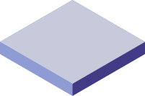
RESULTS
Time: The algorithm runs in O(n⋅n!) time (optimal).
Parallelizing reduces wall-clock time. For example, 4 computers + 4 threads each → ~16x faster.
Correctness: Paths in different trees never overlap (proven in the paper).
Optimize METIS for bubble-sort networks.

Slide 9
THANK YOU
SUMMARY
Problem: Build backup paths in a huge swap-based network.
Solution: A direct (non-recursive) method where every node independently finds its parent.
Parallelization: Split the network (METIS), distribute chunks (MPI), and speed up locally (OpenMP).
Impact: Faster, reliable communication in large networks (e.g., data centers).

